Slide 1
Phase Changes and Density
Standard:
SPS5. Obtain, evaluate, and communicate information to compare and contrast the phases of matter as they relate to atomic and molecular motion.
SPS5.a Ask questions to compare and contrast models depicting the particle arrangement and motion in solids, liquids, gases, and plasmas.
SPS5.b Plan and carry out investigations to identify the relationships among temperature, pressure, volume, and density of gases in closed systems.

Slide 2
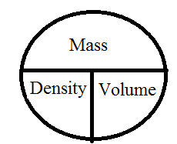
Density
A physical property of matter that can be used to identify a substance is density
Density is a unit of mass per unit of volume
  Recall that mass is measured in grams or kilograms
  Recall that volume is milliliters or liters for liquids and meters cubed (m³) or centimeter cubes (cm³) for solids .
  Scientific Units of density: g/mL or g/cm³ or Kg/m³
Density = mass .
volume
d = m
v

Slide 3
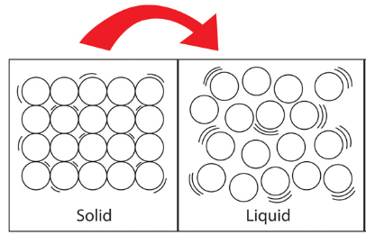
Phase Changes and Density
As most substances go from a solid to a liquid
  Their energy increases
  The attraction between the particle decrease
  And the space between the particle increase
  Since the space between the particles increase most liquids form of substances occupy a greater space (have slightly more volume)
    ** water is one of the few substances that does not do this.
  This means the density of the object slightly decreases as the it melts.

Slide 4
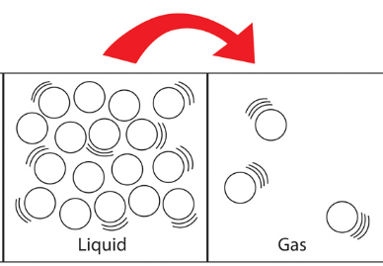
Phase Changes and Density
As ALL substances go from a liquid to a gas
  Their energy drastically increases
  The attraction between the particle drastically decrease, to the point that the attraction between atoms of a gas can be ignored.
  the space between the particle drastically increase
  Since the space between the particles increase ALL gaseous forms of substances occupy a greater space (have considerable more volume)
  This means the density of the object extremely decreases as the it vaporizes.

Slide 5
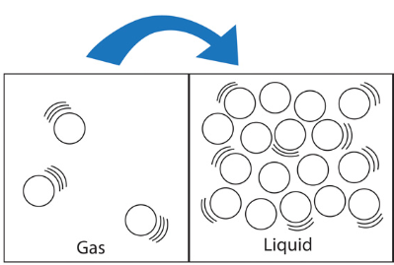
Phase Changes and Density
How does the particle movement, distance and attraction change during condensation?
particles slow down
distance decreases
attraction increases
  But what happens to density as a substance cools from a gas to form a liquid?
since volume decreases the density increases

Slide 6
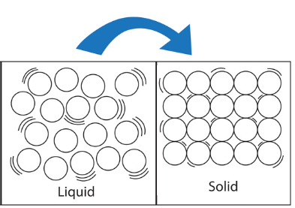
Phase Changes and Density
How does the particle movement, distance and attraction change during freezing ?
particles slow down
distance decreases
attraction increases
  But what happens to density as a substance cools from a liquid to form a solid ?
since volume decreases the density increases

Slide 7
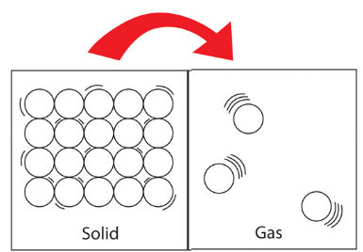
Phase Changes and Density
How does the particle movement, distance and attraction change during sublimation ?
particles speed up
distance increases
attraction decreases
  But what happens to density as a substance changes from a solid to form a gas ?
since volume increases the density decreases

Slide 8
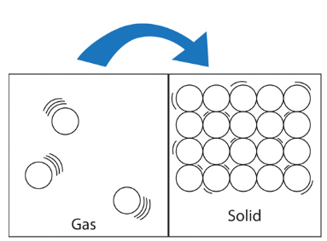
Phase Changes and Density
How does the particle movement, distance and attraction change during deposition ?
particles slow down
distance decreases
attraction increases
  But what happens to density as a substance cools from a liquid to form a solid ?
since volume decreases the density increases

Slide 9
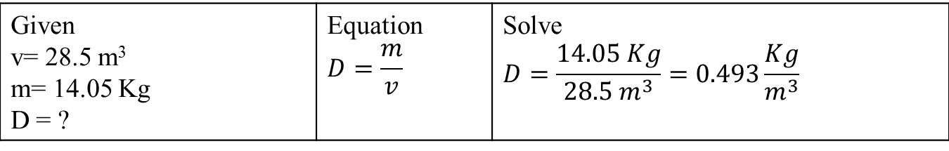
A block of work has a volume of 28.5 m³ and a mass of 14.05 Kg. What is it’s density?
Given v= 28.5 m³ m= 14.05 Kg D = ?

Slide 10
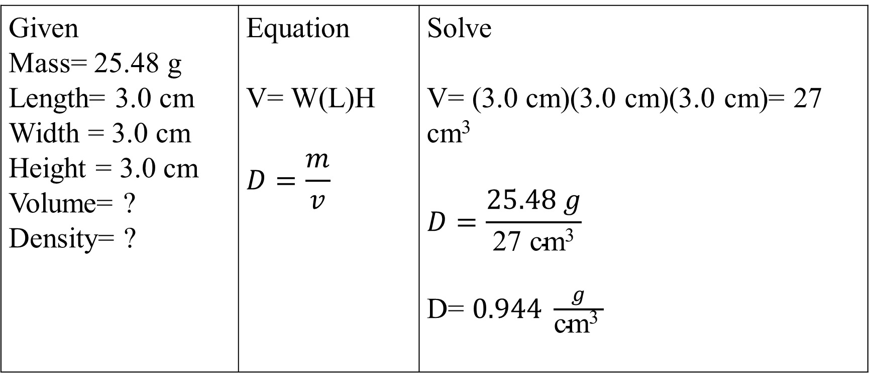
Solving word problems
Robin measured the mass of a metal cube to be 25.48 g and the cube measures 3.0 cm on each side. What is the cube density?
Given Mass= 25.48 g Length= 3.0 cm Width = 3.0 cm Height = 3.0 cm Volume= ? Density= ? | Equation V= W(L)H $$D=\frac{m}{v}$$ | Solve V= (3.0 cm)(3.0 cm)(3.0 cm)= 27 cm³ $$D=\frac{25.48 g}{\text{27 }\text{cm}\text{3}}$$ D= $0.944 \frac{g}{\text{cm}\text{3 }}$

Slide 11
The density of copper is 8.920 g/cm³ if you have 52.75cm³ sample of copper how much does it weigh?
  Given: d = 8.920 g/cm³
  v = 52.75cm³
  m = ?
  Equation: d = m/v or d(v) = m
  Solve: mass = (8.920 g/cm³ )(52.75cm³ ) =
  mass = 470.5 g

Slide 12
A 250.0 g sample of lead occupied what volume? [density of lead is 11.340 g/cm³]
  Given: m = 250 g
  d = 11.340 g/cm³
  v = ?
  Equation: d = m/v or v = m/d
  Solve: v = 250.0 g / (11.340 g/cm³)
  v = 22.05 cm³

Slide 13
Density and Phase Changes
The density of an object is 1.429 g/L after the object changes phase the density changes to 0.999 g/L. What phase change has occurred and what is the current state of matter.
  Density decreased slightly so volume increased
  The object must have melted
  And is now a liquid
The density of an unknown object at STP is 2.429 g/L after the object changes phase the density changes to 500.9 g/L. What phase change has occurred and what is the current state of matter.
  Density increased significantly so the volume decreased considerably
  The object is now a solid
  And should have went form a gas to a solid so it deposit.

Slide 14
Applications of Gas Laws
Standard:
SPS5. Obtain, evaluate, and communicate information to compare and contrast the phases of matter as they relate to atomic and molecular motion.
SPS5.a Ask questions to compare and contrast models depicting the particle arrangement and motion in solids, liquids, gases, and plasmas.
SPS5.b Plan and carry out investigations to identify the relationships among temperature, pressure, volume, and density of gases in closed systems.

Slide 15
Gas Laws and Kinetic Energy
Recall that temperature is a measurement of the average kinetic energy of a substance
If temperature increases the kinetic energy increases
If temperature decrease the kinetic energy decreases
Using Gay-Lussac’s law what happens to the kinetic energy if
  Recall that Gay-Lussac holds volume constant
  IF Pressure is increased
    Temperature must have increased
    So the kinetic energy has increased
  IF Pressure is decreased
    Temperature must have decreased
    So the kinetic energy has decreased

Slide 16
Gas Laws and Kinetic Energy
Using Charles’s law what happens to the kinetic energy if
  -Recall that Charles holds pressure constant
  IF volume is increased
    Temperature must have increased
    So the kinetic energy has increased
  IF volume is decreased
    Temperature must have decreased
    So the kinetic energy has decreased
Using Bolye’s law what happens to the kinetic energy
  Recall that Bolyes holds temperature constant
  So there is NO change in kinetic energy

Slide 17
Application of Gas Laws
Using the gas laws what happens to the temperature if the pressure is doubled and volume is held constant
  Volume is constant so this is Gay-Lussace’s Law
  He states that pressure and temperature are DIRECTLY proportional
  If pressure is doubled then temperature must have doubled
  What happens to the density of the gas?
    Volume is constant, mass is constant so density is constant
Using the gas laws what happens to the volume if the is temperature halved and pressure is held constant
  Pressure is constant so this is Charles law
  He states that volume and temperature are DIRECTLY proportional
  If temperature is doubled then the volume must doubled
  What happens to the density of the gas?
    Volume increases, mass is constant so the density decreases

Slide 18
Application of Gas Laws
Using the gas laws what happens to the volume if the is pressure tripled and temperature is held constant
  Temperature is constant so this is Bolye’s law
  He states that volume and pressure are INVERSLEY proportional
  If pressure is tripled then the volume must be 1/3 the original size
  What happens to the density of the gas?
  The volume decreases, mass is constant so increased

